Slide 1
Automated Troubleshooting
Because work is for suckers.
Pete Lumbis – CCIE #28677, CCDE 2012::3 @PeteCCDE

Slide 2
$whoami
Network Engineer
SE/Datacenter Architect at Cumulus Networks
5 years in Cisco TAC, Routing Escalation
CCIE, CCDE

Slide 3
Change Management
Design
Implement
Troubleshoot

Slide 4
Reality
Troubleshoot
Change
Upgrade
Because Tuesday

Slide 5
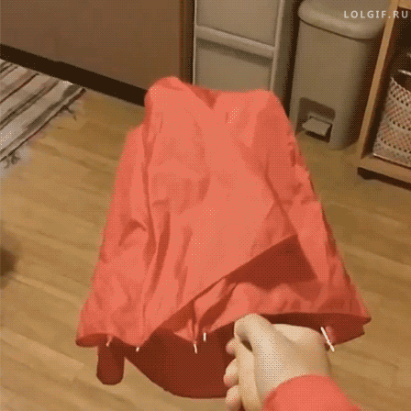
Our Lives

Slide 6
Troubleshooting like a Support Engineer
When did the problem start?
Rely on data, not socialization or opinions.
What evidence do we have?
Has this ever worked?
What are the requirements for this to work?

Slide 7

On Evidence
Observable. Facts.

Slide 8
An Example: New BGP Peer
When did the problem start?
New Config
Rely on data, not socialization or opinions
Show outputs indicate peer isn’t up
What evidence to do we have?
The show commands
Has this ever worked?
Nope
What are requirements for this to work?
Coordinated ASNs, IPs. TCP connectivity

Slide 9
Requirements of a New BGP Peer
Peer IPs coordinate
Who is .1 and who is .2?
Peer ASNs coordinate
Am I expecting the correct ASN that my peer has configured?
TCP/IP Connectivity
Ping?
Telnet on port 179?

Slide 10

Troubleshooting a BGP Peer
Stare and Compare
Ping
Telnet
Debugs, maybe?

Slide 11
Stare and Compare Works
leaf01: router bgp 65001
bgp router-id 10.1.1.1
neighbor 172.16.255.2 remote-as 65531
spine01: router bgp 65531
bgp router-id 10.100.100.1
neighbor 172.16.255.1 remote-as 65001

Slide 12
Until It Doesn’t Work
cumulus@leaf01:~$ net show interface swp51
Name MAC Speed MTU Mode
-- ------------------ ----------------- ------- ----- ------------
UP swp51 (to Spine01) 44:38:39:00:00:5b 1G 1500 Interface/L3
IP Details
------------------------- ---------------
IP: 172.16.255.1/31
IP Neighbor(ARP) Entries: 0
LLDP
------ ---- -------------
swp51 ==== swp1(spine01)

Slide 13
Until It Doesn’t Work
cumulus@leaf01:~$ net show interface swp51
Name MAC Speed MTU Mode
-- ------------------ ----------------- ------- ----- ------------
UP swp51 (to Spine01) 44:38:39:00:00:5b 1G 1500 Interface/L3
IP Details
------------------------- ---------------
IP: 172.16.255.1/31
IP Neighbor(ARP) Entries: 0
LLDP
------ ---- -------------
swp51 ==== swp1(spine01)
router bgp 65001
bgp router-id 10.1.1.1
neighbor 172.16.255.2 remote-as 65531

Slide 14
Until It Doesn’t Work
cumulus@leaf01:~$ net show interface swp51
Name MAC Speed MTU Mode
-- ------------------ ----------------- ------- ----- ------------
UP swp51 (to Spine01) 44:38:39:00:00:5b 1G 1500 Interface/L3
IP Details
------------------------- ---------------
IP: 172.16.255.1/31
IP Neighbor(ARP) Entries: 0
LLDP
------ ---- -------------
swp51 ==== swp1(spine01)
/31 Mask!
router bgp 65001
bgp router-id 10.1.1.1
neighbor 172.16.255.2 remote-as 65531

Slide 15
Until It Doesn’t Work
cumulus@leaf01:~$ net show interface swp51
Name MAC Speed MTU Mode
-- ------------------ ----------------- ------- ----- ------------
UP swp51 (to Spine01) 44:38:39:00:00:5b 1G 1500 Interface/L3
IP Details
------------------------- ---------------
IP: 172.16.255.1/31
IP Neighbor(ARP) Entries: 0
LLDP
------ ---- -------------
swp51 ==== swp1(spine01)
/31 Mask!
Wrong Subnet
router bgp 65001
bgp router-id 10.1.1.1
neighbor 172.16.255.2 remote-as 65531

Slide 16

That Feeling….

Slide 17
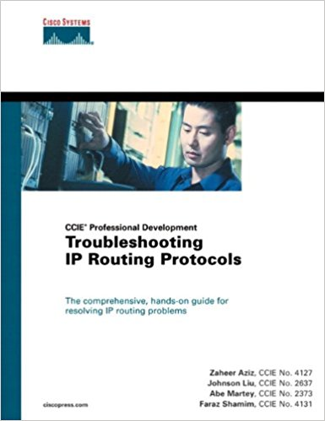
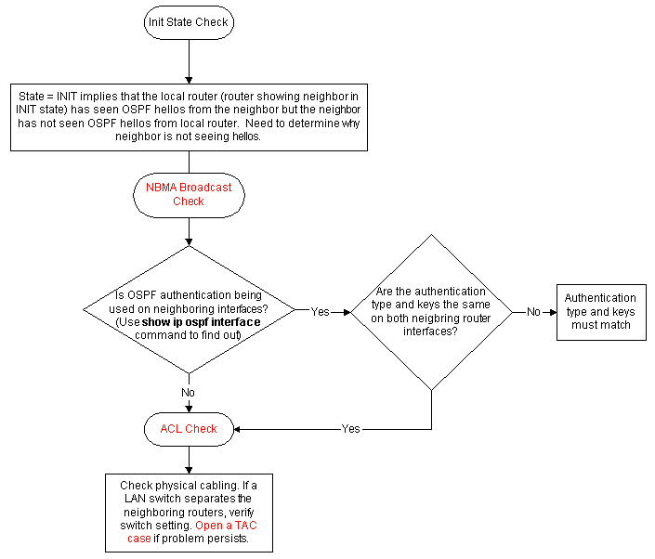
Troubleshooting Flowcharts

Slide 18

Human Error
Observable Data, only as good as the observer
Remove the human

Slide 19
Flowcharts Make Good Programs
If State == Init
Check network type
Check OSPF Authentication
Check L1/L2 connectivity
Else
Escalate

Slide 20

What’s Changed?
APIs, et al.
Abstracting hard stuff
Ansible handles SSH, authentication, etc
REST is easy to use

Slide 21

Let’s Try It!

Slide 22
The Goal
Settle for less
Hard/Impossible to automate everything
Automate most
Jumpstart manual troubleshooting
Push-button Tier 1 Support

Slide 23
Questions?
https://github.com/plumbis/interop17-troubleshooting

